Slide 1

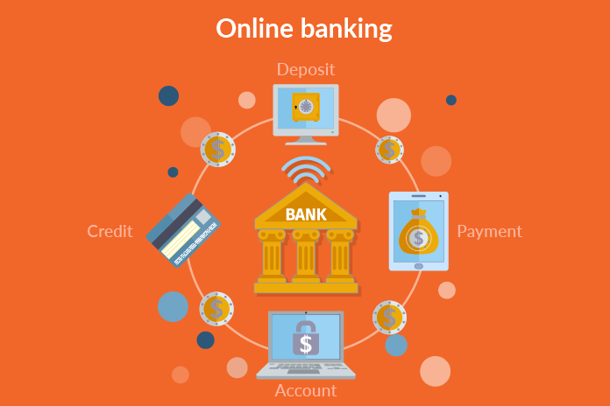
ONLINE BANKING
230 JAVA AK BATCH
RLL GROUP-1

Slide 2
TEAM LEADER – PRATIK TANAJI PATIL TEAM MEMBERS : JAMES X JULAKANTI NIKHITHA MANAS RANJAN ACHARYA NIVETHA PARTHASARATHY RUTUJA SANJAY KAKUSTE AKULA MANASA CHINMAY K S

Slide 3

CONTENTS
Technologies Used
Problem Statement
Objective
The Proposed System
Modules
System Architecture
Sequence Diagram
Database
Flowchart
Output
Testing
Conclusion & Goals

Slide 4
DESCRIPTION
Online banking allows you to conduct financial transactions via the Internet.
You aren't required to visit a bank branch in order to complete basic online banking transactions.
You need a device, an Internet connection to register for online banking.
It's quick, usually free and allows you to do tasks, such as paying bills and transferring money, without having to visit or call your bank.

Slide 5
It ultimately provides you security from online frauds and account hacking.
Transferring funds, registering for new accounts, etc., are all things you can do using Internet banking.
You can only access internet banking if you have an online banking account at any bank.
After registering, users do not have to visit a bank for further steps. This is all handled digitally.

Slide 6




TECHNOLOGIES USED
Front-end :Angular
Back-end: Spring Boot
Database : MySQL
Server Deployment :Tomcat

Slide 7
PROBLEM STATEMENT
Online Bank Management System is a very simple and entry level project developed in java
using spring boot and angular.
Here, A Database is used to store all the details of customer account in a table.
This system is a simple project and useful for those who want to learn Java fs
Users can login, do withdrawal, Request a Deposit amount, Transfer amount from one account to another account, check his/her current balance, cheque book request and Loan request and view reports of all the transactions.

Slide 8
OBJECTIVES
The Main objective of Online Banking System is to manage the details of Accounts, Internet Banking, Online Transaction and Balance check. It manages all the information about User as well as Admin.
Online Banking has been in the form of automatic teller machines and telephone transactions.
It has been transformed by the Internet, a new delivery channel for banking services that benefits both customers and banks.
Easy access to financial and non-financial banking products/services.

Slide 9

IMPLEMENTATION:
ANGULAR IMPLEMENTATION:
Angular is used to develop the frontend application. As a framework, Angular has clear advantages while providing a standard structure for developers to work with. Angular is
a frontend framework that allows developers to write once and deploy to multiple platforms.
SPRINGBOOT IMPLEMENTATION:
Springboot is used perform the backend application. It is used to develop the API and operations like add, update, delete and view. It also help in connecting to MYSQL Database.

Slide 10
THE PROPOSED SYSTEM
The development of this new system contains the following activities,
Customer must have a User- Id and Password to login to the system.
The System provides the all bank operations like deposit, withdraw, cheque book, loan request and funds transfer between the two accounts.
The System providing the fully secured login features.

Slide 11
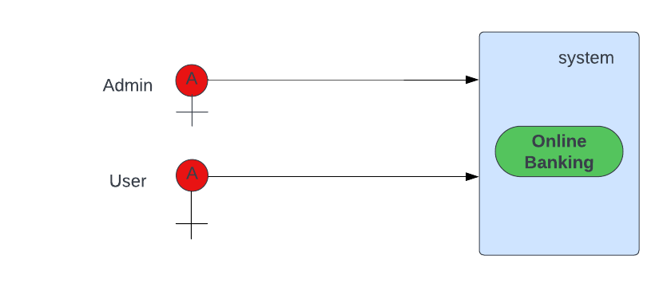
USE CASE DIAGRAM

Slide 12

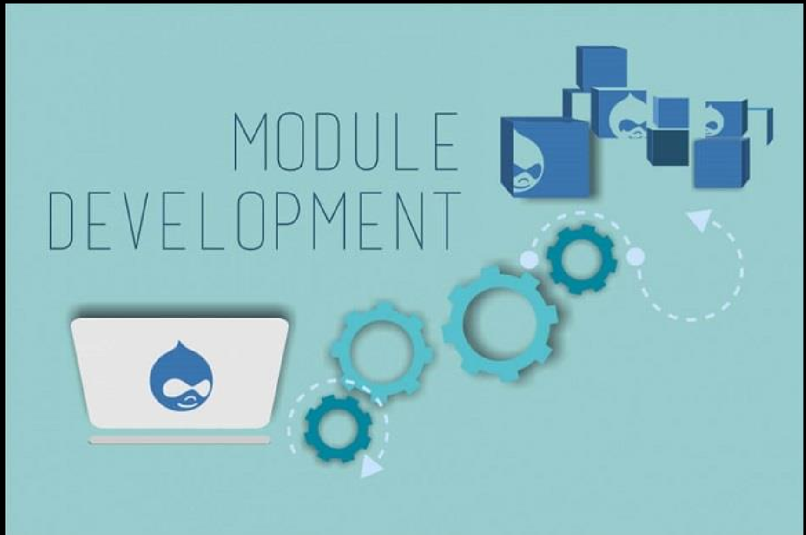
MODULES
The Modules involved are,
Login Module
Register Module
Admin Module
User Module

Slide 13
MODULE CONTD…
REGISTER MODULE:
In this module the user have to enter details like Name, email id, Date of Birth, PAN Number, Password and Address.
➢
➢

Slide 14
MODULE CONTD…
LOGIN MODULE:
In this module the User can Login to their Account using their Username and Password.
This Username and Password is Case Sensitive.
The User Should Login with the correct Credentials.
➢
➢

Slide 15
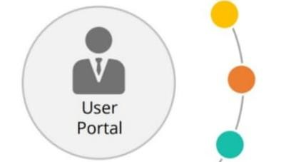

MODULE CONTD…
ADMIN MODULE:
The Admin Can View the Users Detail’s.
The Admin Approve the Cheque Book Requests.
The administrator can also lock the user accounts.
➢
➢

Slide 16
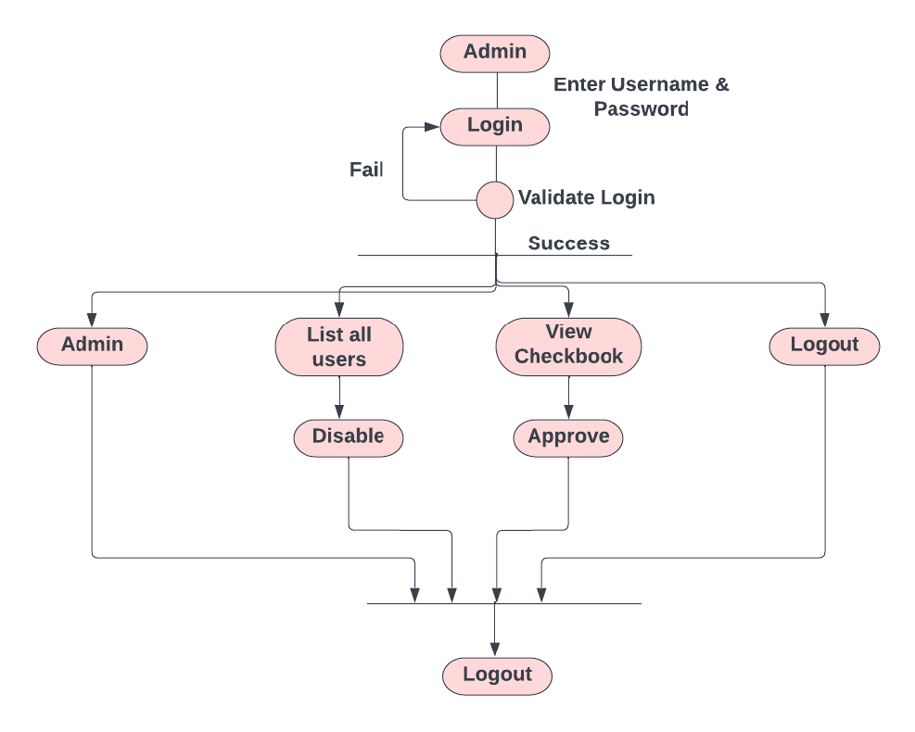
ADMIN ACTIVITY DIAGRAM

Slide 17
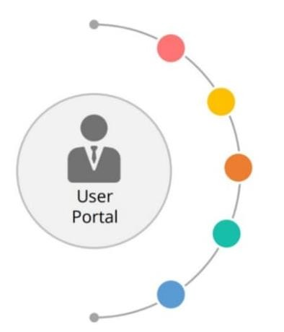
MODULE CONTD...
USER-MODULE:
Register or Login to the Application.
Deposit and Withdraw Money from the Account. View the Balance in Primary and Savings Account.
Chequebook Requests for Different Accounts.
Loan Request for User.
User can do the Transaction.

Slide 18
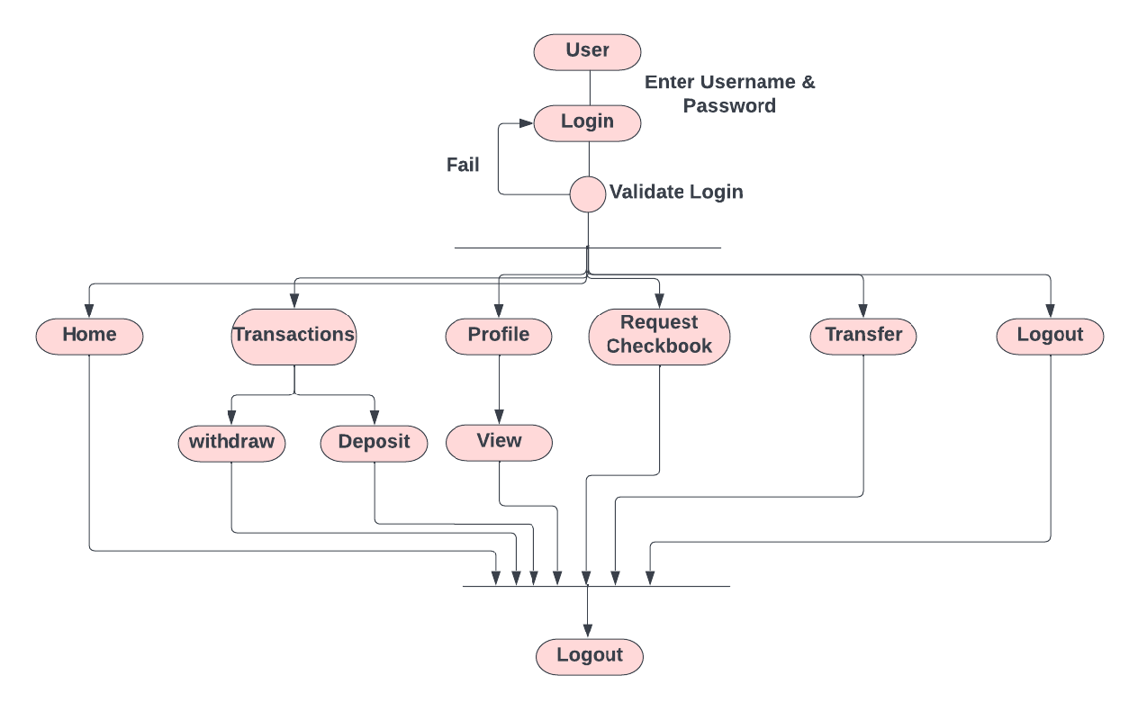
USER ACTIVITY DIAGRAM

Slide 19

MODULE CONTD…
SECURITY AND AUTHENTICATION MODULE:
The user details should be verified against the details in the user tables.
If it is valid, they user should be entered into the system.
Once entered, based on the user type access to the different modules is to be enabled /disabled.

Slide 20
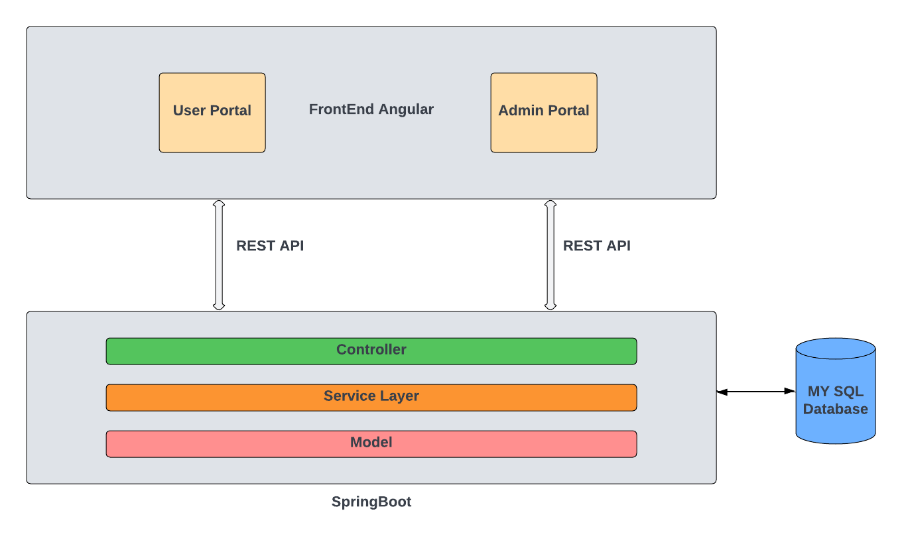
SYSTEM ARCHITECTURE

Slide 21
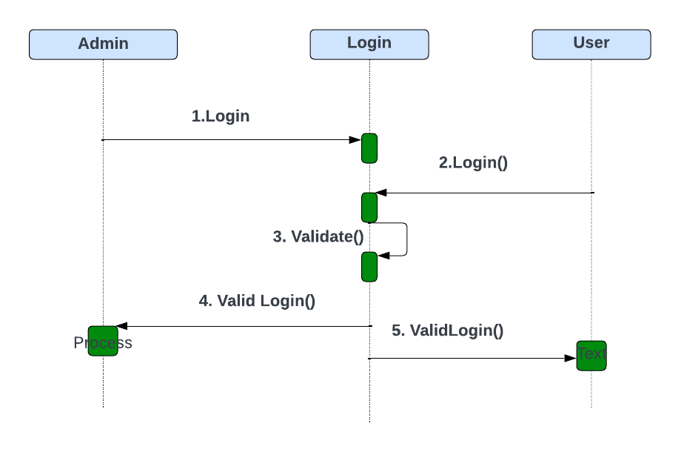
LOGIN SEQUENCE DIAGRAM

Slide 22
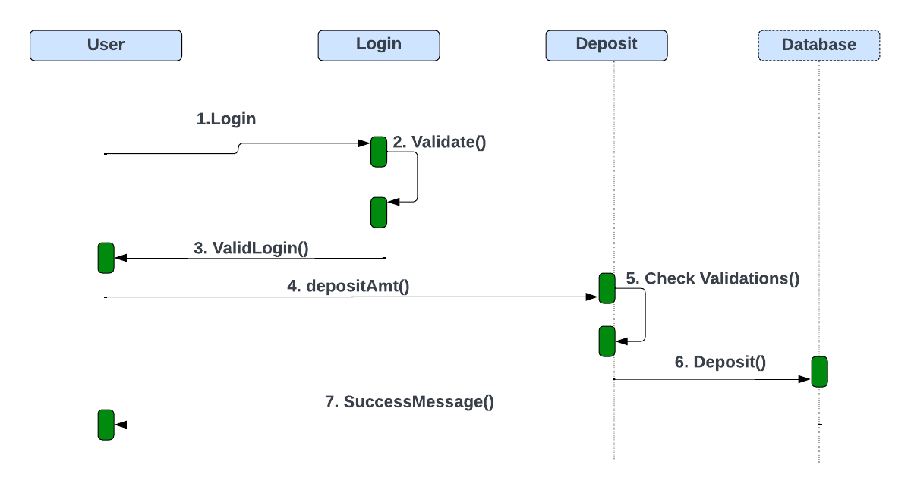
DEPOSIT SEQUENCE DIAGRAM

Slide 23
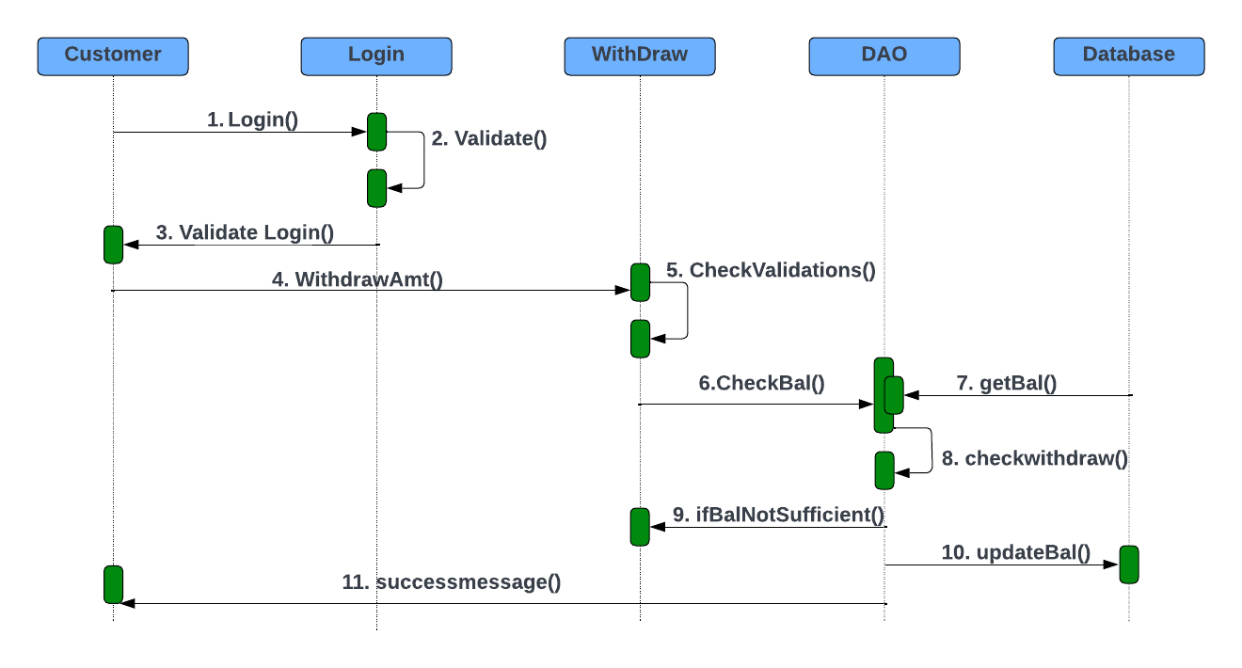
WITHDRAW SEQUENCE DIAGRAM

Slide 24
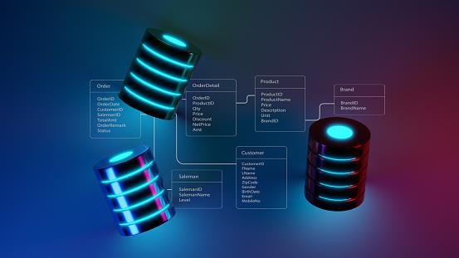
DATABASE
Database : Online Banking
Tables:
Account
Account_loan id
Account_transaction id
Admin
Loan
Transaction
User
User_accountno

Slide 25

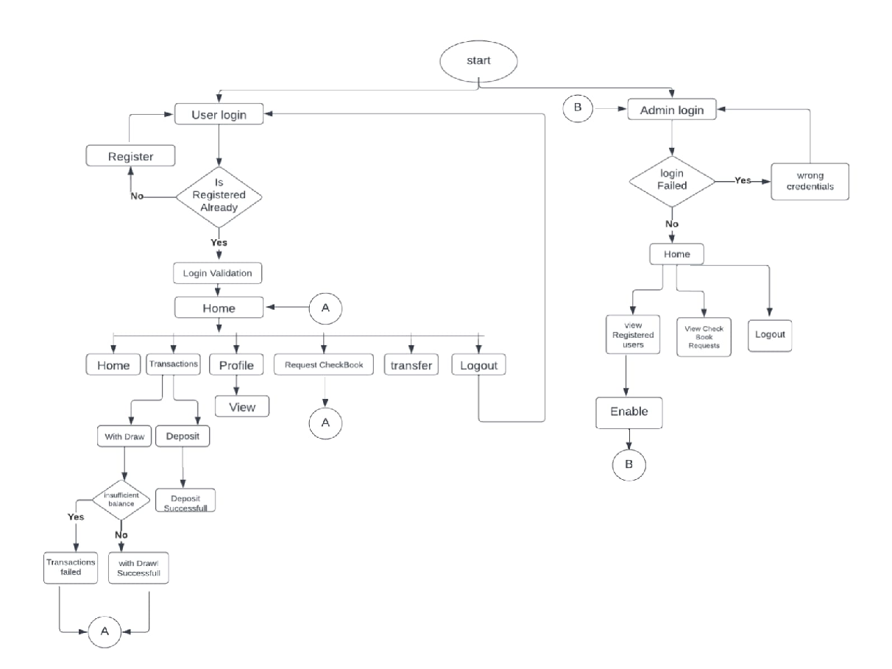
FLOW CHART

Slide 26
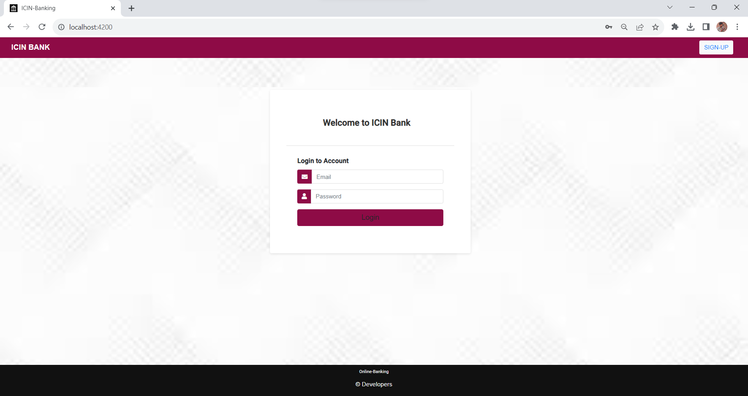
OUTPUT : HOME PAGE

Slide 27
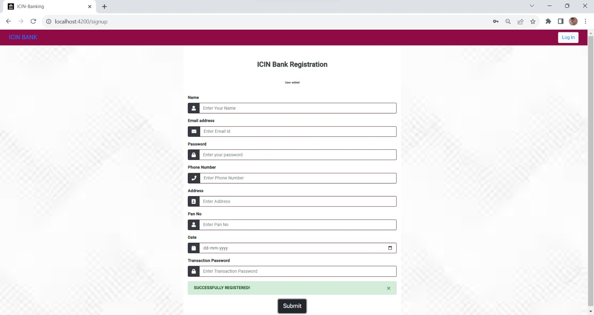
SIGNUP:

Slide 28
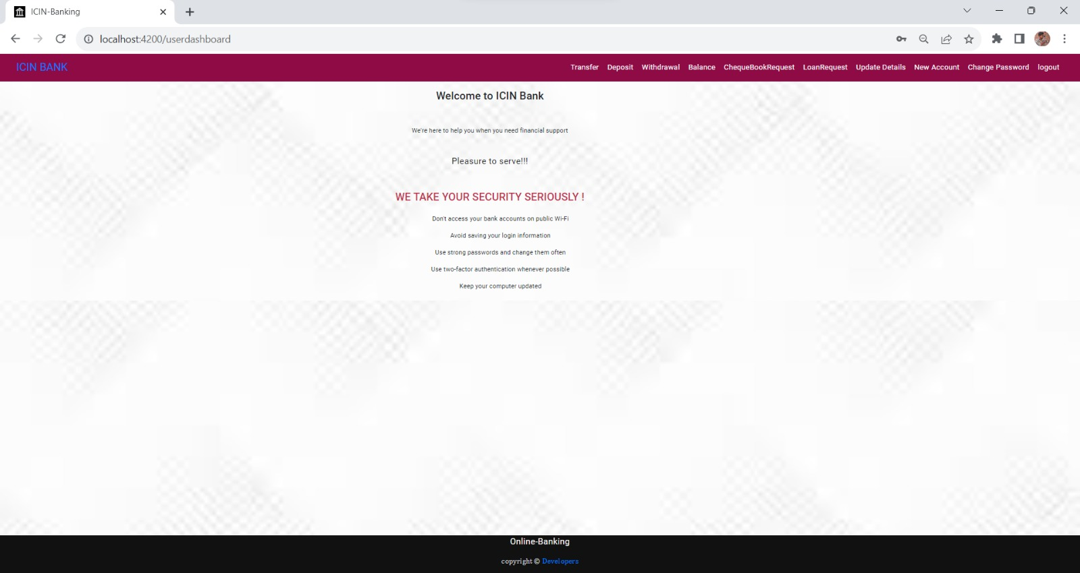
USER DASHBOARD:

Slide 29
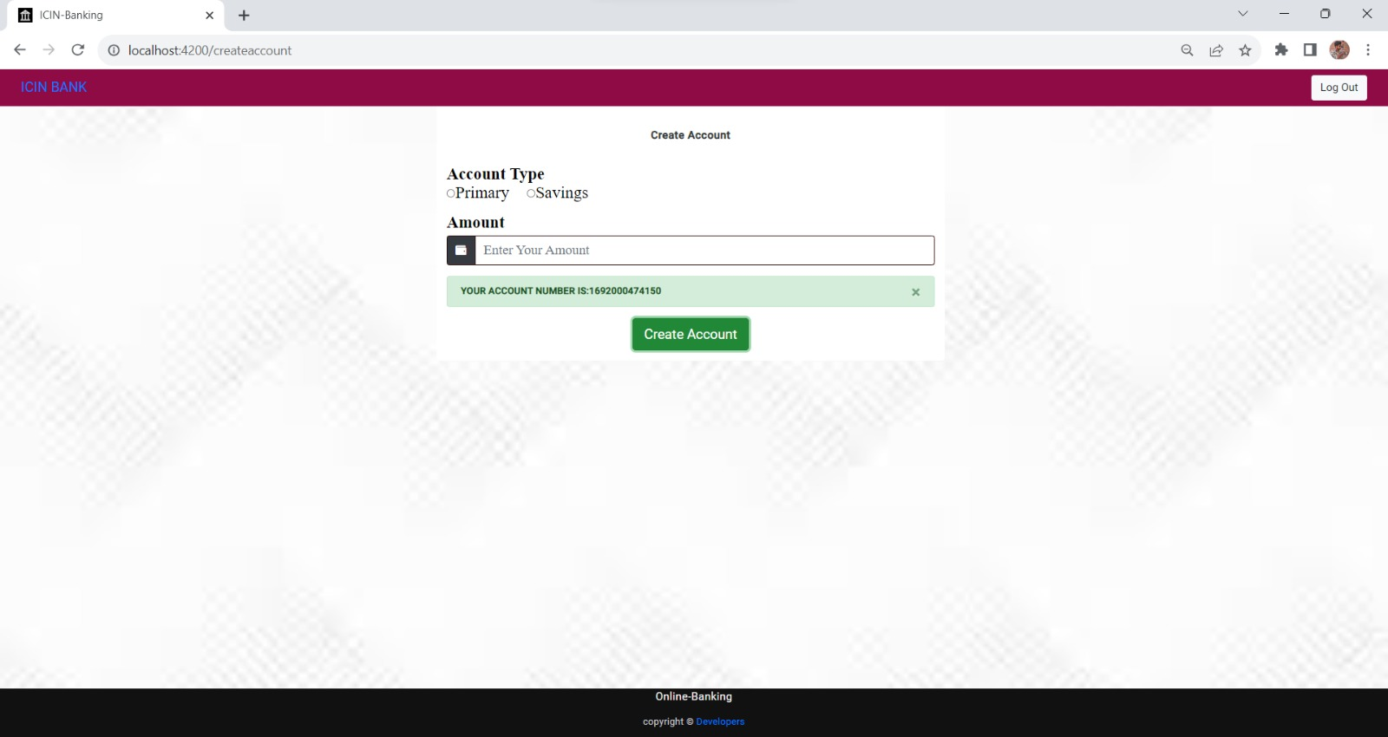
USER FUNCTIONALITIES

Slide 30
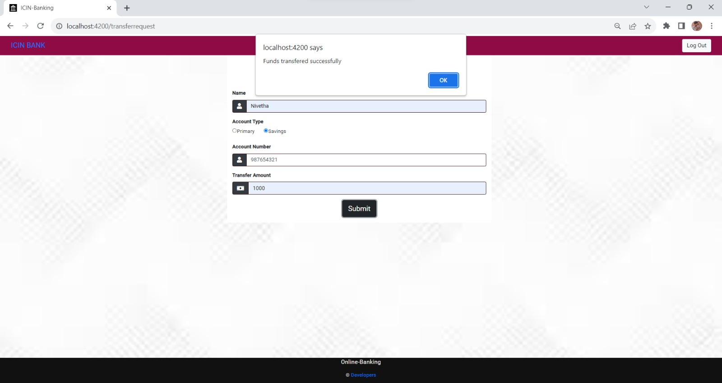
TRANSFER FUND

Slide 31
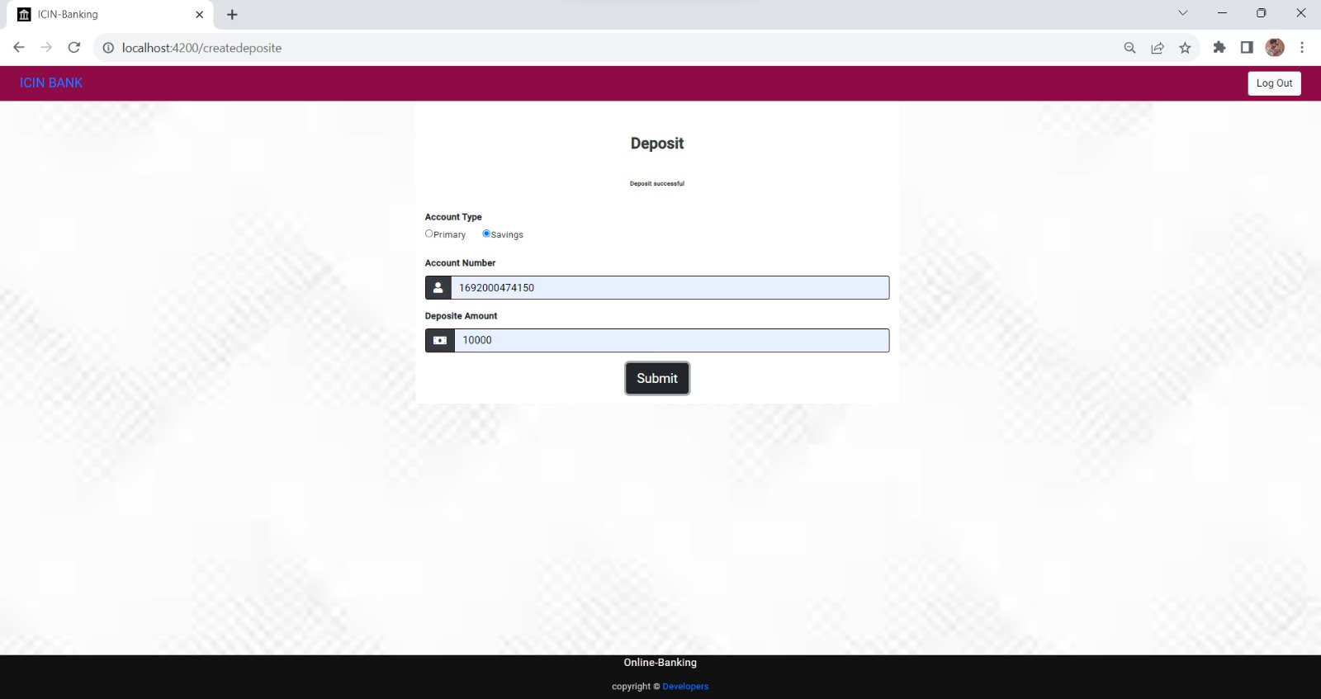
DEPOSIT

Slide 32
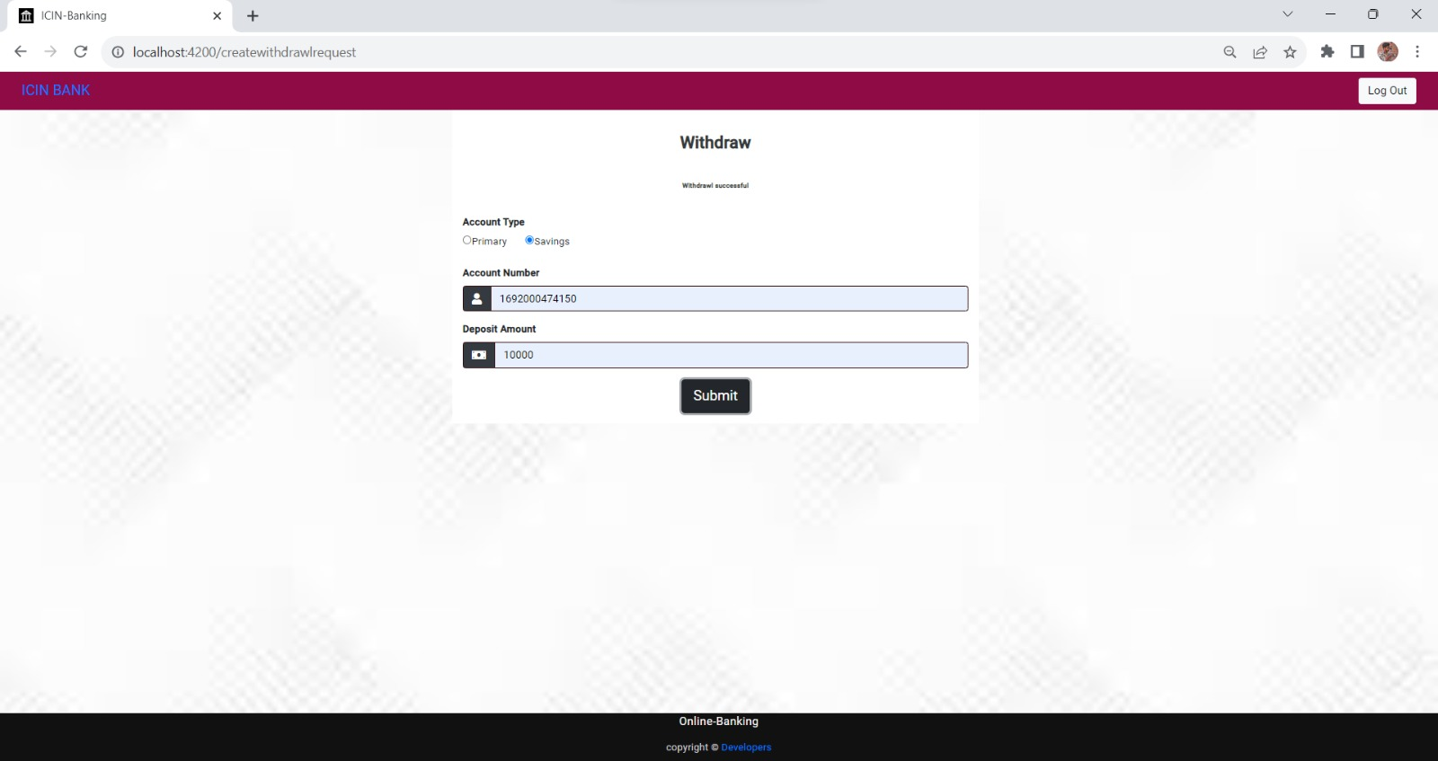
WITHDRAW

Slide 33
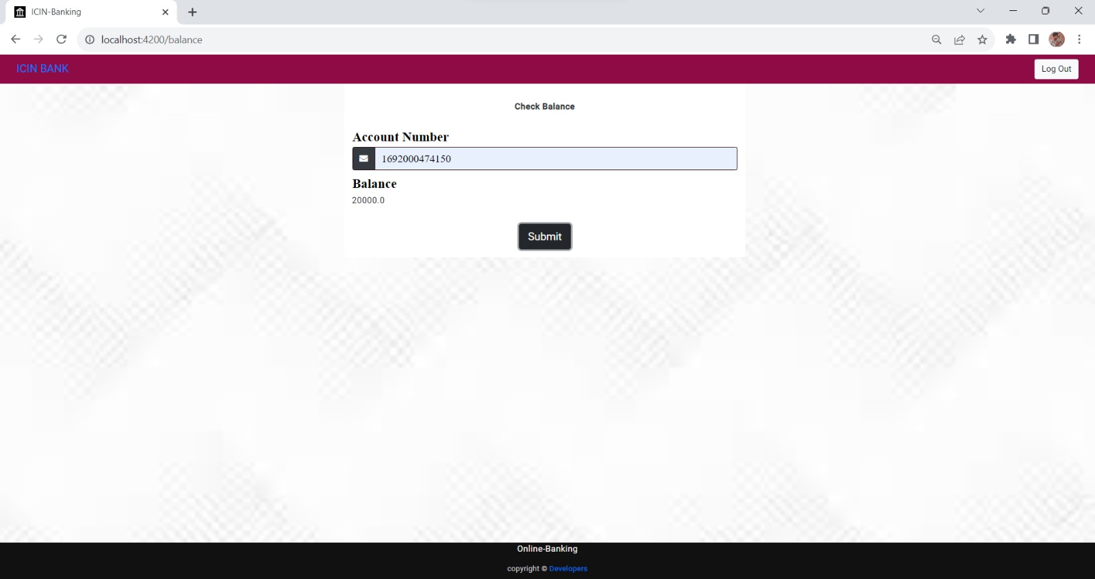
BALANCE

Slide 34
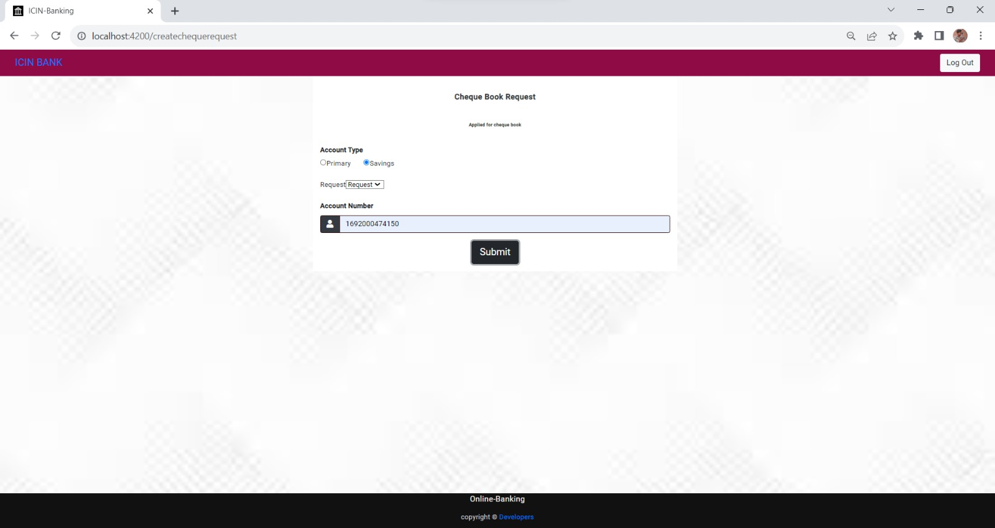
CHEQUE BOOK REQUEST

Slide 35
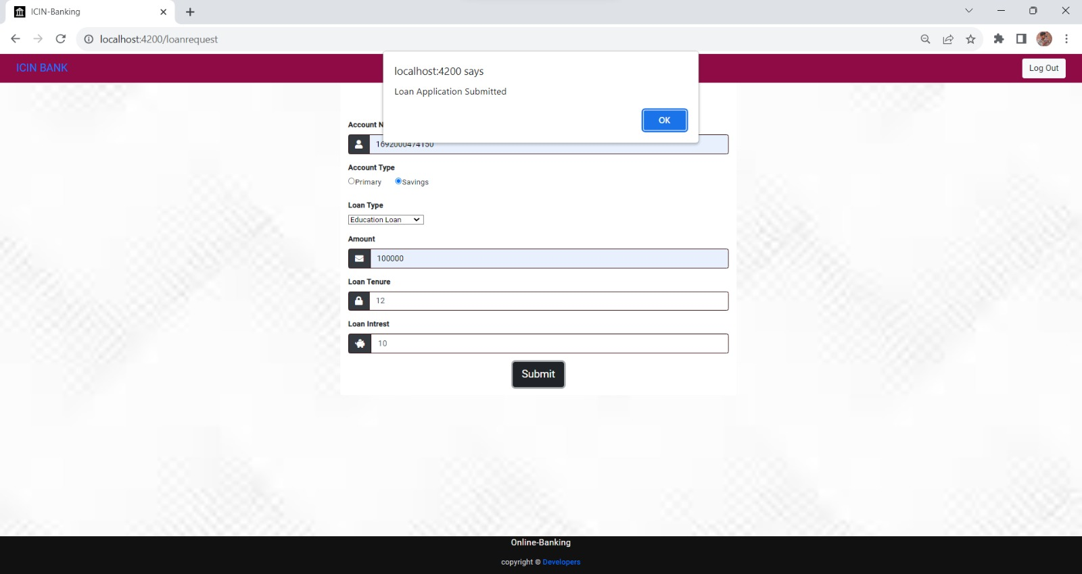
LOAN REQUEST

Slide 36
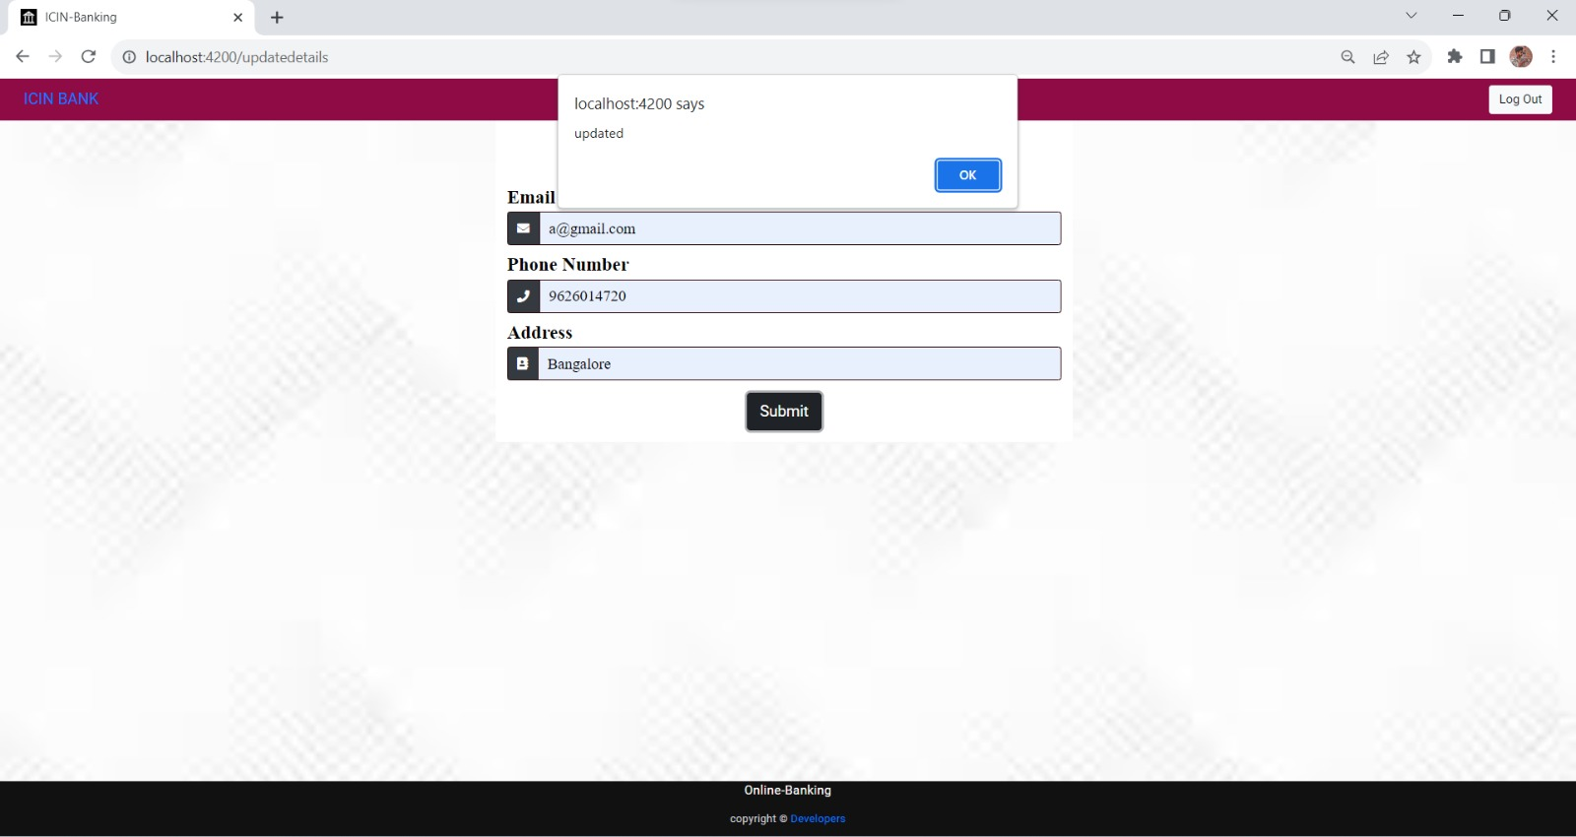
UPDATE DETAILS

Slide 37
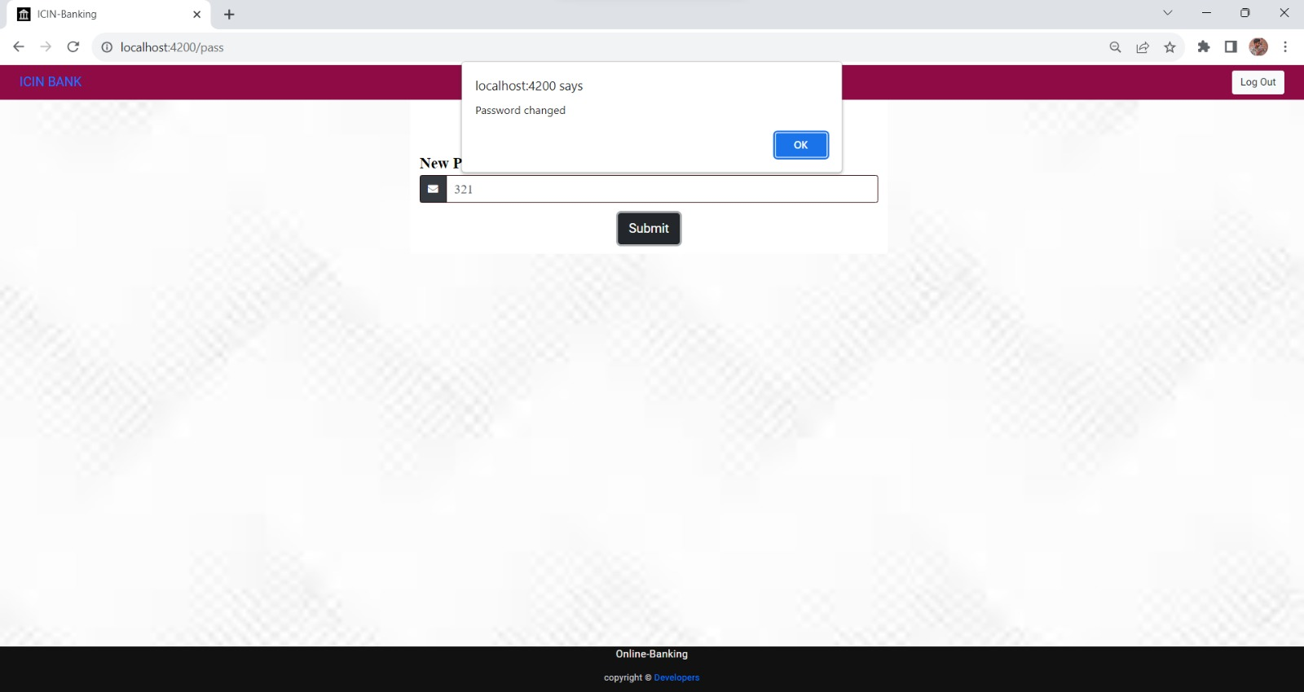
CHANGE PASSWORD

Slide 38
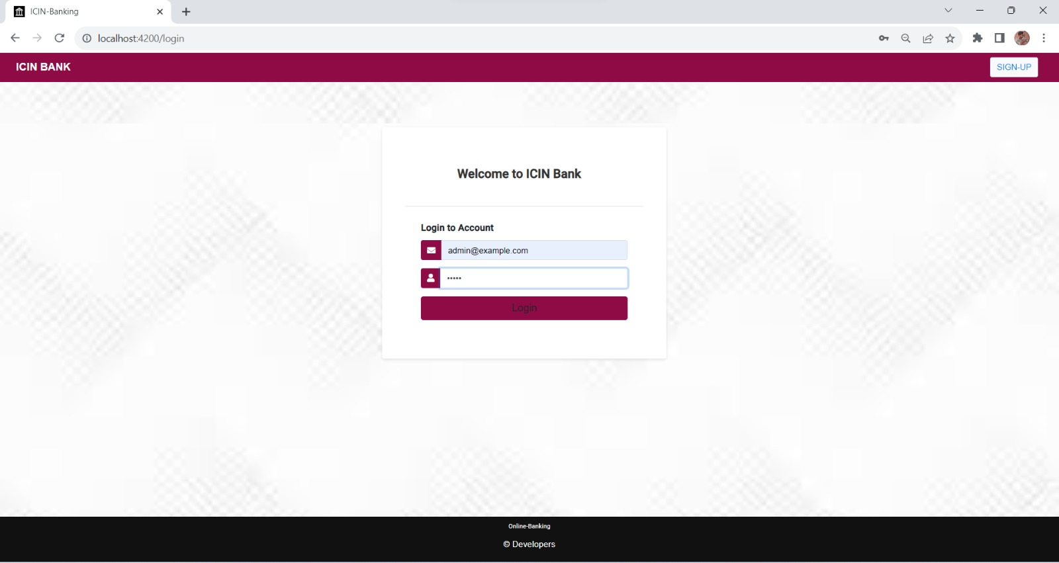
ADMIN LOGIN

Slide 39
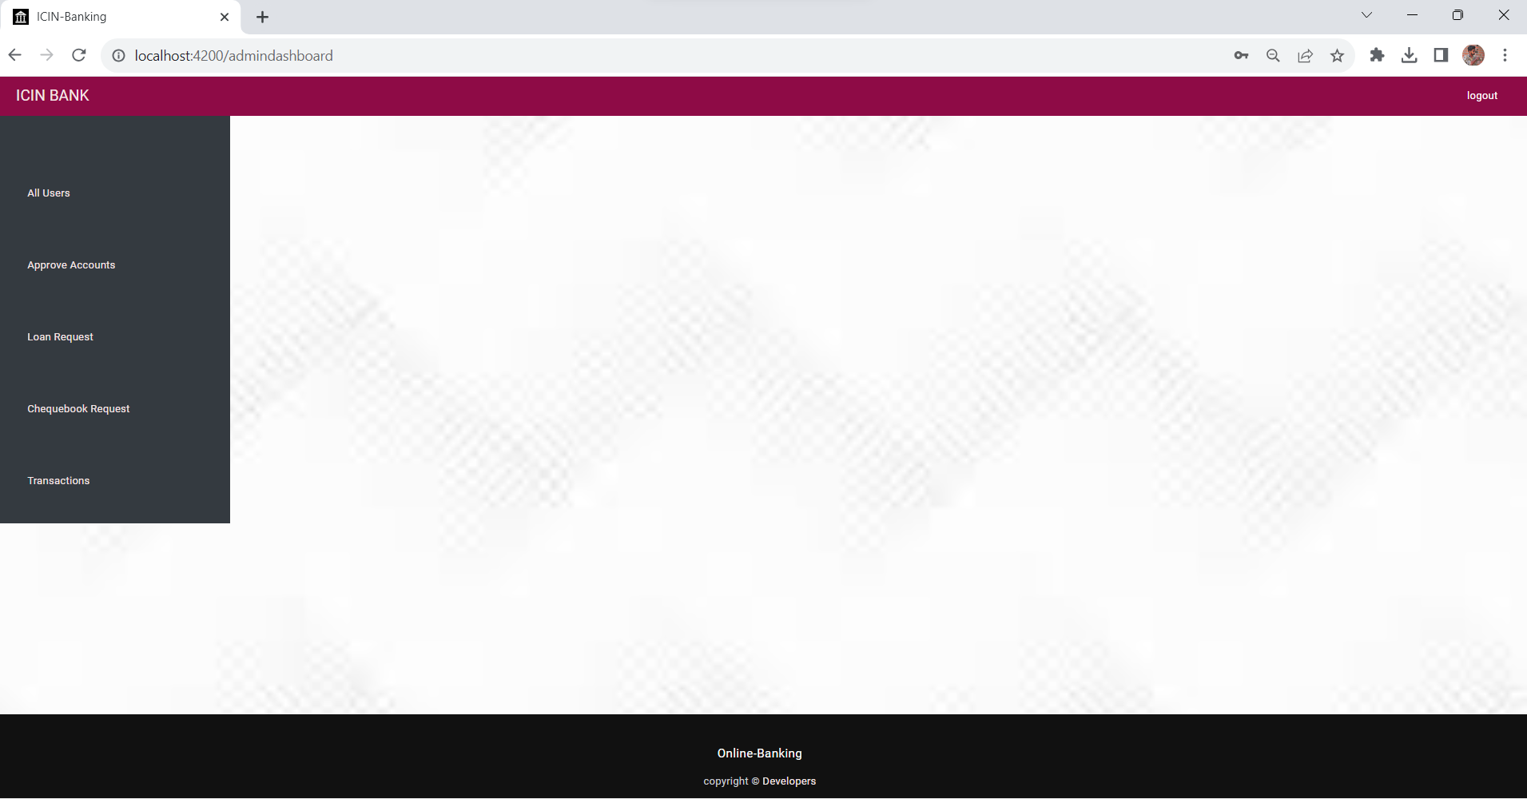
ADMIN DASHBOARD:

Slide 40
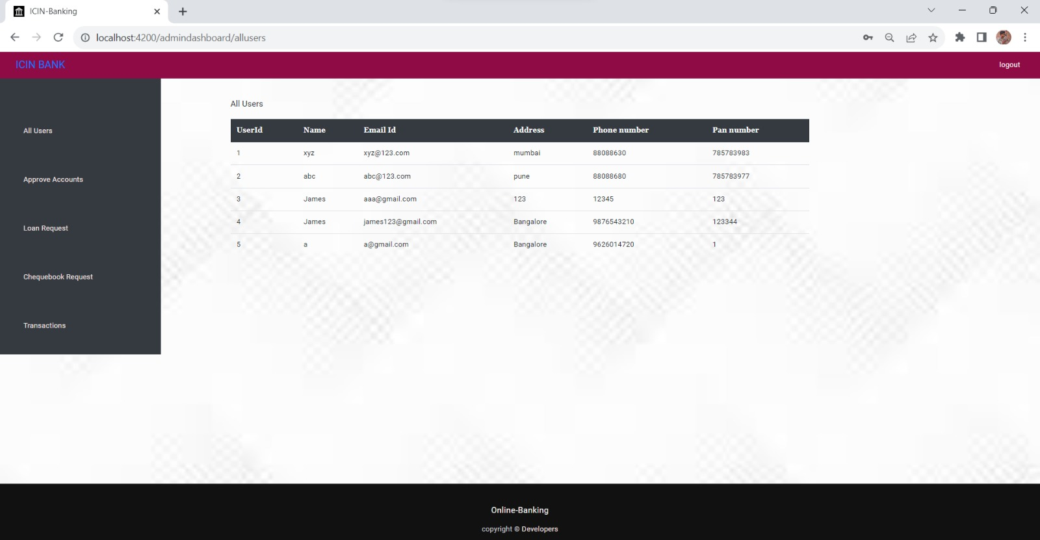
ALL USERS

Slide 41
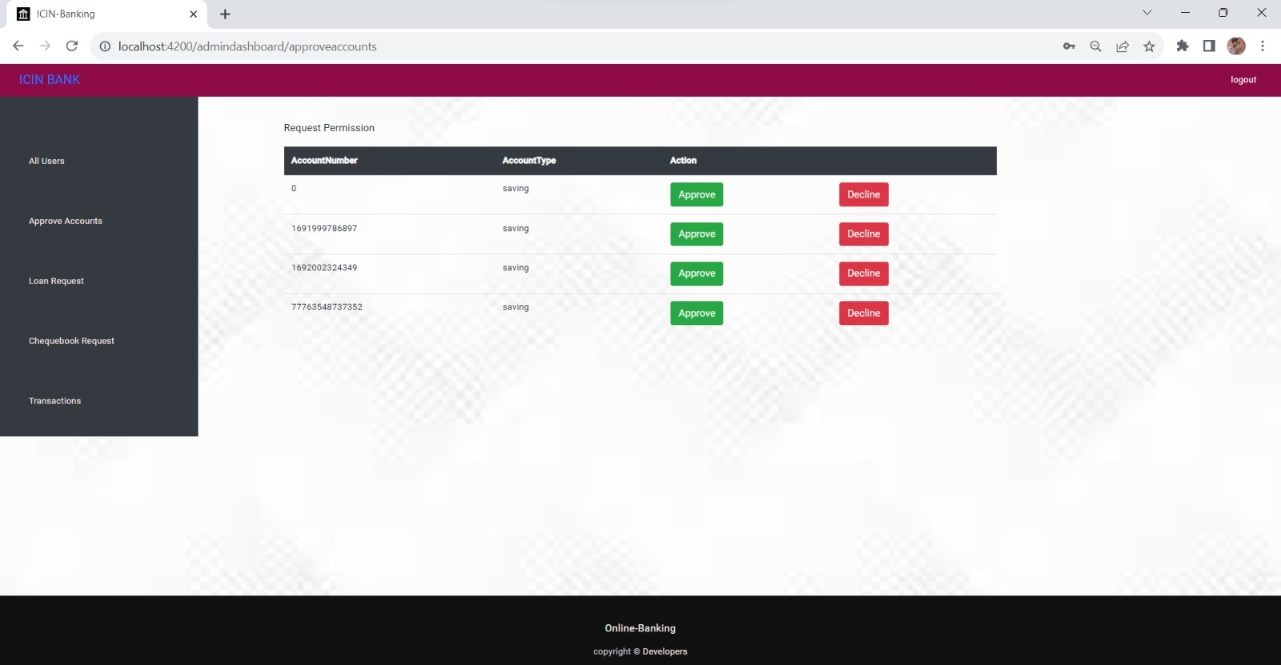
APPROVE ACCOUNTS

Slide 42

APPROVE LOAN REQUEST

Slide 43
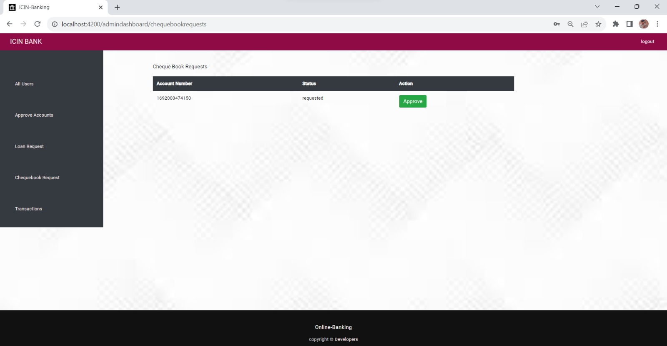
APPROVE CHEQUEBOOK REQUEST:

Slide 44
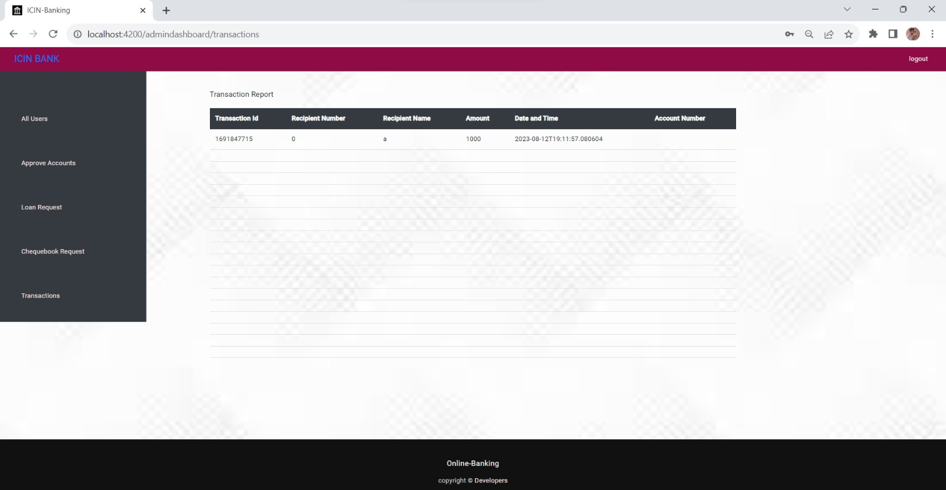
TRANSACTIONS

Slide 45

TESTING
Testing is done with:
Functional testing.
Functional testing:
Postman is an application that allows us to test API's utilizing a graphical user interface. Some of Postman's advantages include the collection feature and the possibility to create different testing environments.

Slide 46
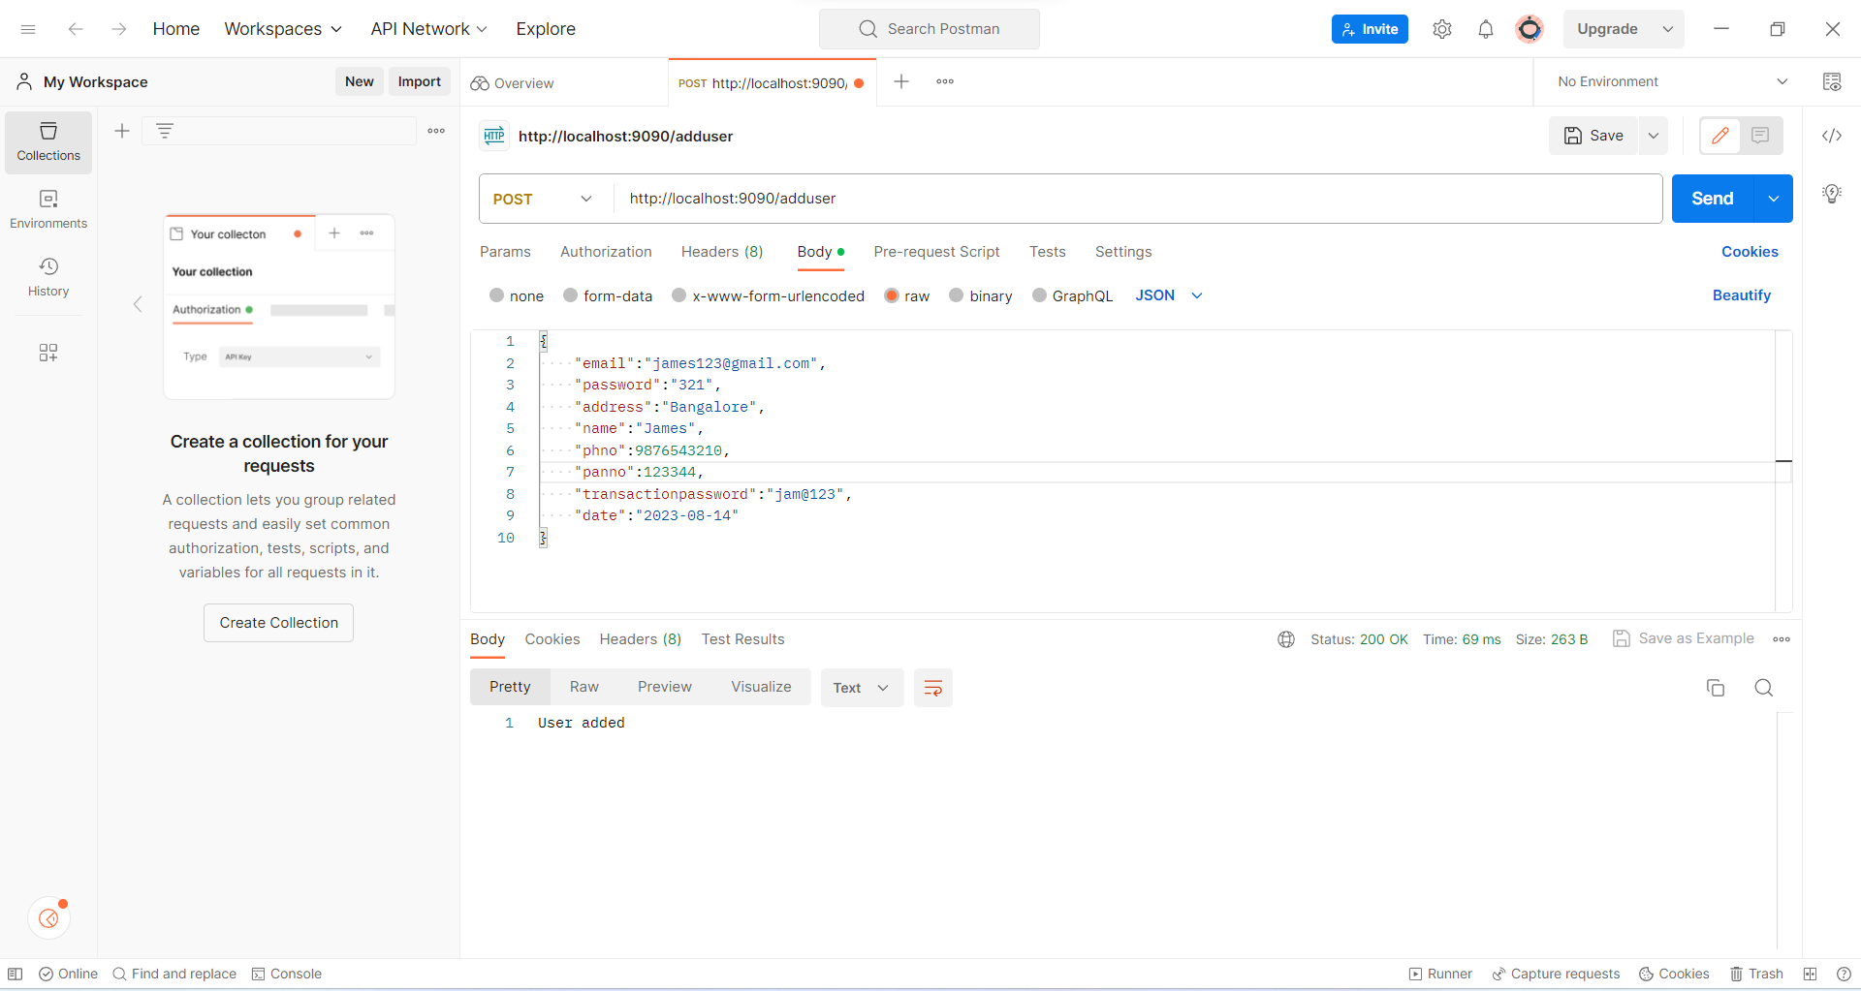
TESTING - FUNCTIONAL TESTING

Slide 47
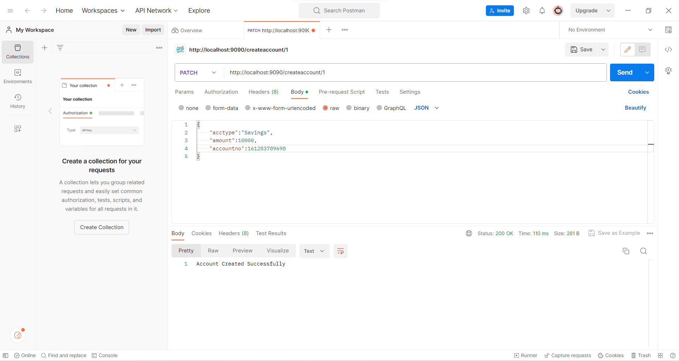
TESTING

Slide 48

CONCLUSION
The “OnlineBanking” was successfully designed and tested for accuracy and quality.
During this project we have accomplished all the objectives and this project meets the needs of the organization.
The developed will be used for searching, retrieving and generating information for the concerned requests.

Slide 49

GOALS
Reduced entry work.
Easy retrieval of information.
Reduced errors due to human intervention.
User friendly screens to enter the data.
Portable and Flexible for further enhancement
Fast finding of requested information.

Slide 50


